Slide 1
Development of master curricula for natural disasters risk management in Western Balkan countries
Project finance and financial reporting
Dr. Saša S. Nikolić
University of Niš
Kick-off meeting/ 15.-16. December 2016. Niš, Serbia
Project number: 573806-EPP-1-2016-1-RS-EPPKA2-CBHE-JP
"This project has been funded with support from the European Commission. This publication reflects the views only of the author, and the Commission cannot be held responsible for any use which may be made of the information contained therein"

Slide 2
Development of master curricula for natural disasters risk management in Western Balkan countries
“Key-players”, in this project:
Partners:
1 contractor
12 partners
Contractor:
University of Niš (= UNI)
Partners come from 7 different countries.

Slide 3
Development of master curricula for natural disasters risk management in Western Balkan countries
Contract with Agency
Contract between
Agency (=EACEA) & Contractor (=UNI) was signed
Project Ref. Nr.: 573806-EPP-1-2016-1-RS-EPPKA2-CBHE-JP
Duration of project: 36 Months
Project title: Development of master curricula for natural disasters risk management in Western Balkan countries

Slide 4
Development of master curricula for natural disasters risk management in Western Balkan countries
NatRisk Budget Info
The grant shall be of a maximum of EUR 1,245,746.00 and shall take the form of:
Staff costs: 350,700 EUR
Travel costs: 80,510 EUR
Costs of stay 181,275 EUR
Equipment costs: 264,800 EUR
Subcontracting: 48,000 EUR
Special Mobility Strand: 320,461 EUR
Total project expenditures: 1,245,746 EUR

Slide 5
Development of master curricula for natural disasters risk management in Western Balkan countries
Installments from EACEA to the Project coordinator
pre-financing payment of 50% of the maximum amount upon entry into force of the Agreement
second payment of 40% of the maximum amount if:
at least 70% of the previous pre-financing installment is spent
the statement of costs incurred and the request for payment is sent to EACEA
the progress report on the implementation of the Action (Intermediate report) is sent to EACEA
balance of 10% upon the approval of the Final Report

Slide 6
Development of master curricula for natural disasters risk management in Western Balkan countries
Exchange rate
Infor Euro
http://ec.europa.eu/budget/contracts_grants/info_contracts/inforeuro/inforeuro_en.cfm
Exchange rate which we will used :
On the month of the first pre-financing for all costs incurred until the second pre-financing is received
On the month of the second pre-financing for all costs incurred until the end of the project

Slide 7
Development of master curricula for natural disasters risk management in Western Balkan countries
Eligible costs
Budget headings
Our budget is divided into the next six categories i.e., budget lines:
I – Staff Costs
II/ III – Travel costs and Costs of stay
IV – Equipment costs
V – Subcontracting
VI – Special Mobility Strand

Slide 8
Development of master curricula for natural disasters risk management in Western Balkan countries
Staff Costs (Max 40% of the total eligible direct costs)
Budget Line Staff Costs has four categories:
Manager (legislators, senior officials and managers)
Teacher/Trainer, Researcher (typically carry out academic activities related to curriculum/training programme development, development and adaptation of teaching/training materials, preparation and teaching of courses or trainings)
Techican (technicians and associate professionals)
Adminastrative (office and customer service clerks)
You can find all the details in Programme Guide (https://ec.europa.eu/programmes/erasmus-plus/resources_en)
(ERASMUS+ Programme Guide; Guidelines for administrative & finantial management and reporting)

Slide 9
Development of master curricula for natural disasters risk management in Western Balkan countries
Staff Costs - Financial evaluation - Supporting documents
To keep with project accounts (requested in case of financial check):
STAFF CONVENTION (ANNEX II) for each person employed ORIGINAL
TIME-SHEETS (attached to each staff convention), indicating number of days worked for corresponding month/year, description of tasks , outputs produced and related work package ORIGINAL
ANY EVIDENCE allowing to verify that declared workloads correspond to actual activities/outputs (e.g. attendance lists for lectures given, tangible outputs / products, salary slips, etc.) Certified copy
EMPLOYMENT CONTRACT Certified copy
PROOF OF PAYMENT (net + taxes) Certified copy
TAX STATEMENT (if applicable by national law) Certified copy

Slide 10
Development of master curricula for natural disasters risk management in Western Balkan countries
Staff Costs - Supporting documents
Staff Convention Form
signed by task performer,
signed and stamped by the person responsible (e.g. Rector, Vice-rector)
For different staff categories, separate convention forms
Time sheet
indicating date of the service provided
indicating number of days worked
indicating the task performed
signed by task performer and by the person responsible

Slide 11
Development of master curricula for natural disasters risk management in Western Balkan countries
Staff costs Example
Petar Petrović – 1080 Eur for 10 manager days:
Net 649.08
Income tax 108.00
Social security 322.92
Gross 1080.00 Eur

Slide 12
Development of master curricula for natural disasters risk management in Western Balkan countries
Travel costs and Costs of stay - Supporting documents
For the purposes of any financial evaluation and/or audit, beneficiaries will have to be able to justify / prove the following elements:
the journeys are directly connected to specific and clearly identifiable project-related activities
the journeys actually took place (original boarding pass, original hotel invoices, attendance list, agendas, etc.).
Travel costs
Costs of stay (120EUR per day)
Distance | Eligible cost
100 – 499 km | 180 Eur
500 – 1999 km | 275 Eur
2000 – 2999 km | 360 Eur
3000 – 3999 km | 530 Eur
4000 – 7999 km | 820 Eur
8000 km and more | 1100 Eur
No. of days | Eligible cost
1 | 120
2 | 240
3 | 360
4 | 480
5 | 600
6 | 720

Slide 13
Development of master curricula for natural disasters risk management in Western Balkan countries
Travel costs and Costs of stay - Supporting documents
Travel costs
The travel distance identified will be used to calculate the corresponding unit cost. Each unit cost applied will contribute to the costs of travel for the round trip, regardless of the expenses actually incurred.
Costs of stay
In order to apply the correct unit cost, the beneficiary must identify the duration in days of the activity (including the travel from their place of origin to the venue of the activity and vice-versa) and apply the corresponding unit costs.
Each unit cost applied will contribute to the costs of stay regardless of the expenses actually incurred.
Source: Guidelines for the Use of the Grant for grants awarded in 2016 under Call EAC/A04/2015

Slide 14
Development of master curricula for natural disasters risk management in Western Balkan countries
Travel costs and costs of stay - Example
Travel: Nis (RS) – Vienna (AT), 4 days
Distance: 691.70 km => 275 Eur
Distance calculator
http://ec.europa.eu/programmes/erasmus-plus/tools/distance_en.htm
Stay costs: 4 days => 480 Eur

Slide 15
Development of master curricula for natural disasters risk management in Western Balkan countries
Travel costs and Costs of stay - Supporting documents
individual travel report (ITR) - SIGNED & filled - ORIGINAL
table of specificaltion of travel and stay costs Certified copy
travel order/decision (if applicable) Certified copy
proof that the trip actually took place (e.g. travel tickets, boarding passes, invoices, receipts, attendance list) Certified copy
proof of payment for travel costs (bank statement) Certified copy
proof of payment for stay cost (bank statement) Certified copy
proof of payment for taxes (if any) Certified copy

Slide 16
Development of master curricula for natural disasters risk management in Western Balkan countries
Equipment - Supporting documents
For the purposes of any financial evaluation and/or audit, beneficiaries will have to be able to justify / prove the following elements:
The declared costs are identifiable and verifiable, in particular being recorded in the accounting system of the Beneficiary.
The equipment is properly registered in the inventory of the institution concerned. NOTICE: All equipment must be Labelled with E+ stickers
The following should, however, be retained with the project accounts: Invoice(s) for all purchased equipment (please note that order forms, pro-forma invoices, quotations or estimates are not considered as proof of expenditure). Certified copy
VAT exemption statement Certified copy
Documentation on the tendering procedure and three quotations (for more than 25000 Euros) Certified copy
Proof of payment (bank statement) Certified copy
When the threshold of EUR 25 000 is exceeded, documentation on the tendering procedure and three quotations are needed. In such cases, the beneficiaries may not split the purchase of equipment into smaller contracts with individual amounts lower than the EUR 25 000 threshold.

Slide 17
Development of master curricula for natural disasters risk management in Western Balkan countries
Sub-Contrating-Supporting documents
Typical activities which may be sub-contracted (provided they are not carried out by beneficiaries' staff):
Evaluation activities and auditing
IT courses
Language courses
Printing, publishing and dissemination activities
Translation services
Web design and maintenance
Invoices, subcontracts and bank statements Certified copy

Slide 18
Development of master curricula for natural disasters risk management in Western Balkan countries
Some notices
You should inform us if:
There is a change of contact (researcher, accountant, head of your organisation, …)
The name of your organisation changes
Your adress, phone or e-mail changes
Your legal representative changes
Your bank account changes

Slide 19
Development of master curricula for natural disasters risk management in Western Balkan countries
Reimbursement basis | Budget Headings | Documents to retain with project accounts | Documents to be sent with the Final report
ACTUAL | Equipment | Invoices Bank statements Tendering procedure for expenses exceeding 25.000€ Proof that the equipment is recorded in the inventory of the institution | Invoices and three quotations from different suppliers for expenses exceeding 25.000€ Any prior authorisation from the Agency
 | Subcontracting | Subcontracts Invoices Bank statements Tendering procedure for expenses exceeding 25.000€ Tangible outputs/products* | Subcontracts, invoices and three quotations from different suppliers for expenses exceeding 25.000€ Any prior authorisation from the Agency
UNIT | Staff | Formal employment contract Staff convention Time sheets Agendas* Attendance / Participant lists* Tangible outputs/products* Minutes of meetings* | No supporting documents should be sent with the Final report, except for any prior authorisation from the Agency
 | Travel and Costs of Stay | Individual Travel Report (ITR) Invoices, receipts, boarding passes* Agendas* Attendance / Participant lists* Tangible outputs/products* Minutes of meetings* | No supporting documents should be sent with the Final report, except for any prior authorisation from the Agency
For all grants, a Certificate on the action's financial statements and underlying accounts ("Report of Factual Findings on the Final Financial Report – Type II") must be sent with the Final report (see Annex VII of the Agreement). * Example of supporting documents

Slide 20
Ineligible costs
Development of master curricula for natural disasters risk management in Western Balkan countries
Return on capital
Debt, debt service charges, provisions for losses or debts
Interest owed
Exchange losses
Costs of transfers from the agency charged by the bank of a beneficiary
Costs declared by another action receiving EU grant
Contributions in kind from third parties
Excessive or reckless expenditure
Deductible VAT

Slide 21
Development of master curricula for natural disasters risk management in Western Balkan countries
Rules for designation of reference numbers for supporting documents
Coding SC and ITR documents
EXAMPLE 1:
If we have documents, referring to Staff Costs (SC), we use next approach for coding Staff Convention document (Annex II).
P9 is a ninth participant of the project. In our case, that is University of Messina from Italy.
P9 – SC – 001
P9 order number of participants
SC- STAFF CONVENTION (Staff Costs -Budget Headings)
001÷100 we use three or four digits, depending on how many of these documents you expect by the end of the project.
EXAMPLE 2:
If we have documents, referring to Travel Costs and Costs of Stay, we use next approach for coding Individual Travel Report (ITR) (Annex III):
P9 – ITR – 001
P9-order number of participants
ITR- Individual Travel Report (Travel Costs and Costs of Stay-Budget Headings)
001÷100 we use three or four digits, depending on how many of these documents you expect by the end of the project.

Slide 22
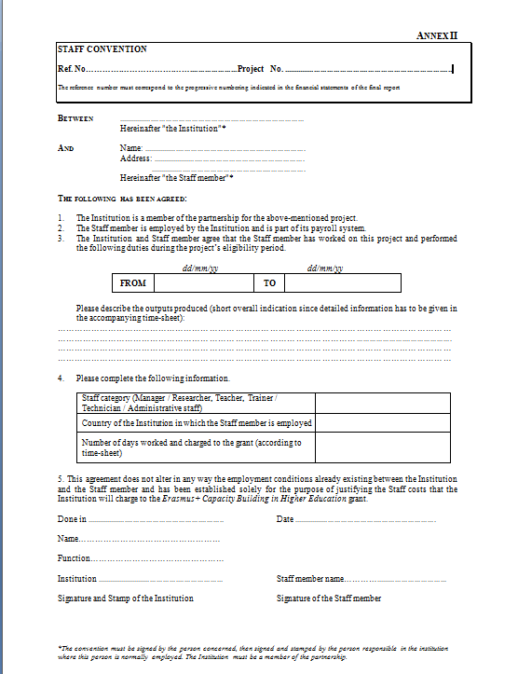
Development of master curricula for natural disasters risk management in Western Balkan countries
P9 – SC – 001
Example 1
573806-EPP-1-2016-1-RS-EPPKA2-CBHE-JP
All documents to be delivered in hard copies and certified (true copy of the primary document)
All these documents which regarding the Staff costs, Travel costs etc, should be scanned and posted on the project platform in the area that provided for this purpose. http://mngt.natrisk.ni.ac.rs/

Slide 23
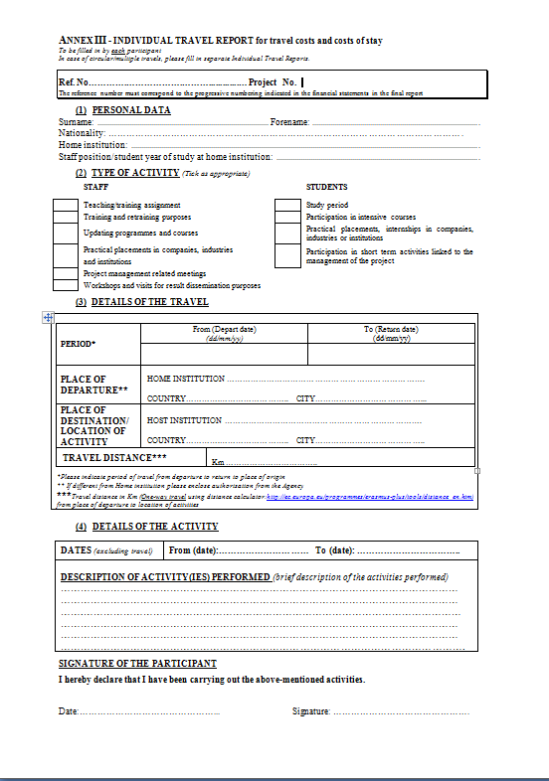
Development of master curricula for natural disasters risk management in Western Balkan countries
P9 – ITR– 001
Example 2
573806-EPP-1-2016-1-RS-EPPKA2-CBHE-JP
All documents to be delivered in hard copies and certified (true copy of the primary document)
Short description

Slide 24
Development of master curricula for natural disasters risk management in Western Balkan countries
Partners’ Report
Technical report
Reporting on the progress of project activities realized at the partner institution
Includes progress indicators
Financial report (Excel table)
Declaring the amount of grant spent in the reporting period
Supporting documents for all declared costs (hard copies= some original documents + certified copy)

Slide 25
Development of master curricula for natural disasters risk management in Western Balkan countries
Partners’ Report
Technical report
Template for the technical report will be included in the Manual for contractual and financial management
Financial report
Financial table with declared costs per categories
Supporting documents for each cost incurred
* All documents to be delivered in hard copies and certified (some original documents and certified copy of the primary document)

Slide 26
Development of master curricula for natural disasters risk management in Western Balkan countries
Milan Gocić
Mail: natriskuni@gmail.com
Saša S. Nikolić
Mail: sasa.s.nikolic@elfak.ni.ac.rs
University of Niš

